Slide 1
Project C.A.S.P.
Week 9, 4/3/17
Ryan Tedeschi
Dylan Carson
Chris Bowlen

Slide 2
Weekly Progress
Outline Module almost completed
Only remaining task: return a formatted response
this will be completed after the Standalone application is ready
Functions by creating a graph containing “block” data
Each block has an ID, and each edge links between the IDs
This is so that the data can be returned as a string and easily reconstructed in a third-party implementation
Analyze module almost completed
Have code to look through for loops and constants
Looking for expression such as ++, > <, and n

Slide 3
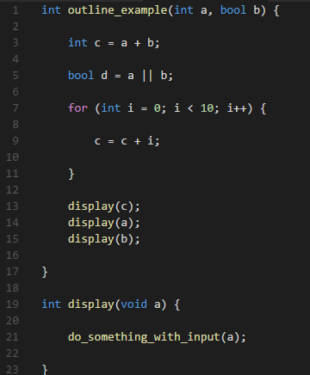
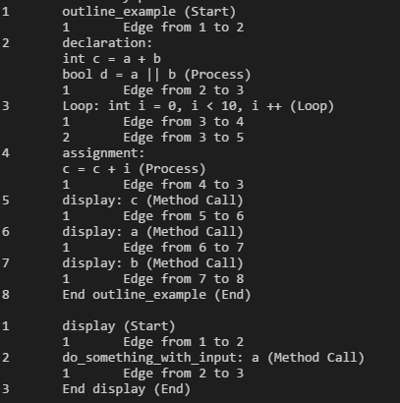
Outline Module: Visual Example

Slide 4
Outline Module: Visual Example
(1) outline_example
(2) declaration:
int c = a + b
bool d = a || b
(1) display
(3) Loop: int i = 0, i < 10, i ++
(4) assignment:
c = c + i
(2) do_something_with_input: c
(5) display: c
(3) End display
(6) display: a
(7) display: b
(8) End outline_example

Slide 5
Weekly Tasks
Ryan – Begin Standalone Implementation
Only focused on the Outline Module, other modules are incomplete or not as important to be represented visually
This will hopefully be completed
Target is to generate the flowchart in the previous slide
Dylan – Complete Analyze Module
Transition to Translate module upon completion
Chris – Translate Module

